Slide 1
AI Powered Collections Strategy
Leveraging Agentic AI for Scalable, Fair, and Effective Debt Management at Geldium | 2026

Slide 2
How the System Works
Inputs (The Data): We collect a holistic view of the customer, including static demographics (Age, Employment Status), financial health metrics (DTI Ratio, Income, Credit Utilization), and temporal behavior (6-month repayment history).
Decision Logic (The Brain): The system uses a hybrid approach. It generates a predictive risk probability using our Random Forest model, and then applies a strict business rule (a customized 15% risk threshold) to determine if an account needs intervention.
Actions (The Intervention): Based on the risk score, the system triggers dynamic interventions. This ranges from automated SMS payment reminders and tailored hardship restructuring offers, to routing complex, high-risk cases to human underwriters.
Learning (The Optimization): The system continuously improves by tracking 90-day customer outcomes (e.g., successful repayment vs. default). It measures the success rate of specific outreach channels and feeds this outcome data back in to update the model's predictive weights.

Slide 3
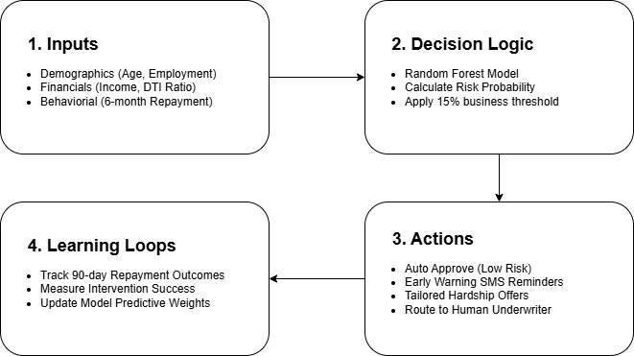
Geldium Ai Collection Workflow

Slide 4
Role of Agentic AI
Maximizing operational scale while maintaining human-centric oversight.
Autonomous (AI Agents) | Human Oversight (Human-in-the-Loop)
Real-time Risk Ingestion: Automatically monitoring DTI shifts and credit score changes 24/7. | High-Risk Deep Dives: Manual investigation of "High-Score Delinquents" to identify sudden life shocks.
Tier-1 Outreach: Initiating immediate SMS and Email reminders for low-to-medium risk accounts. | Complex Negotiations: Direct human intervention for customized hardship plans and large-balance settlements.
Standardized Offers: Generating and sending pre-approved hardship templates based on financial metrics. | Final Restructuring Approval: Human authorization for any significant changes to loan terms or interest rates.
Outcome Tracking: Logging repayment results and automatically updating the model’s weights. | Ethical & Bias Auditing: Reviewing model performance to ensure fairness and compliance with lending laws.

Slide 5
Responsible AI Guardrails
Algorithmic Fairness: We remove geographic proxies (like Location) to prevent redlining and apply debiasing techniques to ensure fair treatment across demographics.
Clear Explainability: Our transparent model allows us to extract the exact logic behind every decision, enabling us to legally generate clear "Adverse Action Notices".
Regulatory Compliance: Built-in fairness audits guarantee continuous adherence to fair lending laws, such as the Equal Credit Opportunity Act.
Human Oversight: AI handles early warnings, but human underwriters are required to authorize all final loan modifications and complex hardship approvals.

Slide 6
Expected Business Impact
Quantitative Business KPIs:
Increased Risk Detection: Successfully identifying and catching over 56% of actual high-risk loans early.
Revenue Protection: Proactively flagging vulnerable accounts to prevent future financial loss.
Cost Efficiency: Drastically lowering costs by shifting from funding bad loans to conducting targeted, low-cost manual reviews.
Quantitative Customer Outcomes:
Fairer Treatment: Ensuring unbiased evaluations by completely dropping unfair socioeconomic proxies, like geographic location.
Enhanced Transparency: Providing clear, understandable reasons for credit decisions through mandated "Adverse Action Notices".
Financial Empowerment: Giving customers the specific feedback they need to proactively improve their financial health.

Slide 7
Questions?
Geldium AI Collections Strategy Team
and
Data Analysis Team

